Slide 1

How-to Video Here:
https://esri.box.com/v/DevSummit2019-HowTo

Slide 2
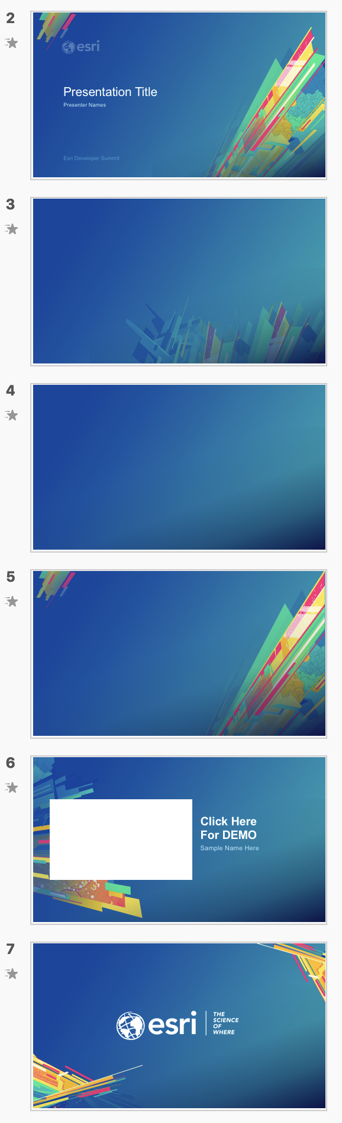
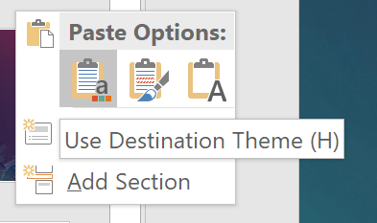
How to apply this template to existing slides
Which background to use?
Title
Open your previous presentation.
Copy all relevant slides from previous presentation to this template. Paste using Destination Theme.
Going slide by slide, copy the Standard Background image of your choice.
Paste and send to back. Windows shortcut: Ctrl+Shift+[
Delete any remaining pieces left from the old background.
For other backgrounds (Title, Section Divider, Demo Intro, and Walkaway) use the provided slides in this template.
Check your fonts. The default font is Arial to maintain consistency across the enterprise. If you used Avenir previously, consider switching to Arial to avoid unknown font substitution by other users. Instructions for changing font themes.
Why not use PowerPoint’s template features?
Standard Background Suitable for Less Content
Standard Background Suitable for More Content
Section Divider
Demo Intro
—
Use behind Images
Walkaway
Notes:
G243257 DevSummit 2019 Template for Esri staff

Slide 3



ArcGIS API for JavaScript: Creating Custom Layers and Layer Views
Jacob Wasilkowski
@JWasilGeo
2019 ESRI DEVELOPER SUMMIT
Palm Springs, CA
Notes:
G243257 DevSummit 2019 Template for Esri staff

Slide 4

Agenda
Intro to custom Layers and LayerViews in JSAPI 4.x
Examples to guide and inspire
Deep dive into “Earth at Night, Mountains of Light” custom elevation layer

Slide 5
Extending Layer and LayerView in 4.x
Custom Layer (for 2D MapView and 3D SceneView)
esri/layers/BaseDynamicLayer
esri/layers/BaseElevationLayer
esri/layers/BaseTileLayer
Custom LayerView (for 2D MapView)
esri/views/2d/layers/BaseLayerView2D
esri/views/2d/layers/BaseLayerViewGL2D
(TODO CHANGE THIS URL TO PUBLIC) https://jscore.esri.com/javascript/latest/api-reference/esri-views-2d-layers-BaseLayerViewGL2D.html
Custom externalRenderers (for 3D SceneView)
esri/views/3d/externalRenderers

Slide 6
Extending Layer and LayerView in 4.x
Custom Layer
Layers are for data access; they do not have direct visual representation
Why create a custom layer?
To connect to a service not supported (yet) by the JSAPI
To manipulate data client-side before it is displayed in a MapView or SceneView
To mash up multiple services to create new visualizations
Limitations
Suited for static content
No control over when it redraws
Limited to image formats and tiles

Slide 7
Extending Layer and LayerView in 4.x
Custom LayerView (2D only)
Represents the view of a Layer after it has been added to a Map
Responsible for calling a Layer’s API to get data and redraw
Canvas or WebGL is exposed to draw anything you want in a MapView
Custom externalRenderers (3D only)
WebGL is exposed to draw anything you want in a SceneView

Slide 8
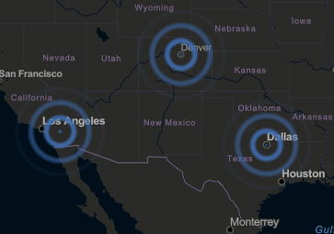
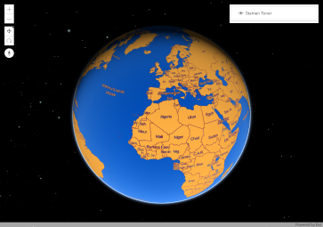
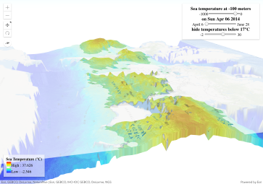
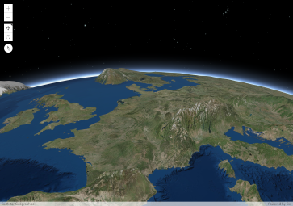
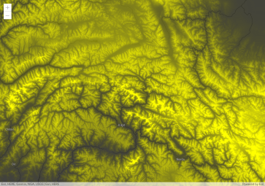
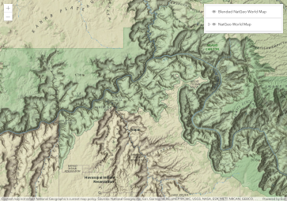
Examples of what’s possible: http://esriurl.com/jsCustomLayers

Slide 9

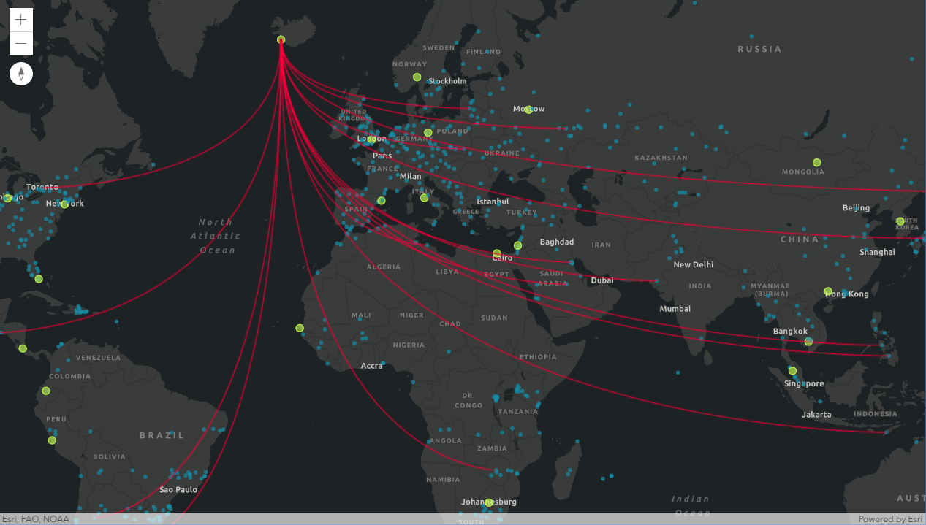
Demo
Canvas-Flowmap-Layer
Custom BaseLayerView2D
https://github.com/sarahbellum/Canvas-Flowmap-Layer

Slide 10
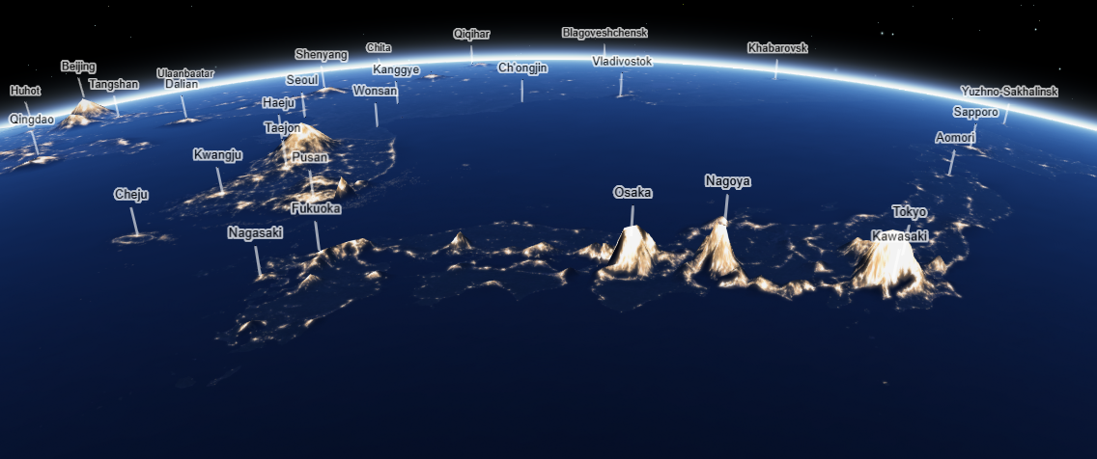
Deep dive: “Earth at Night, Mountains of Light”

Slide 11
Deep dive: “Earth at Night, Mountains of Light”
Custom BaseElevationLayer with NASA nighttime lights tiled image service
Final product:
https://jwasilgeo.github.io/esri-experiments/earth-at-night/
Blog post with more details:
https://petrichor.studio/

Slide 12
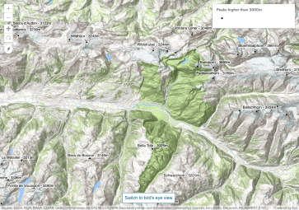
Deep dive: “Earth at Night, Mountains of Light”
Inspired by 3 official JSAPI samples:
BaseElevationLayer – Exaggerating elevation: http://esriurl.com/15250
BaseElevationLayer – Thematic data as elevation: http://esriurl.com/15251
Using callout lines with labels: http://esriurl.com/15252

Slide 13
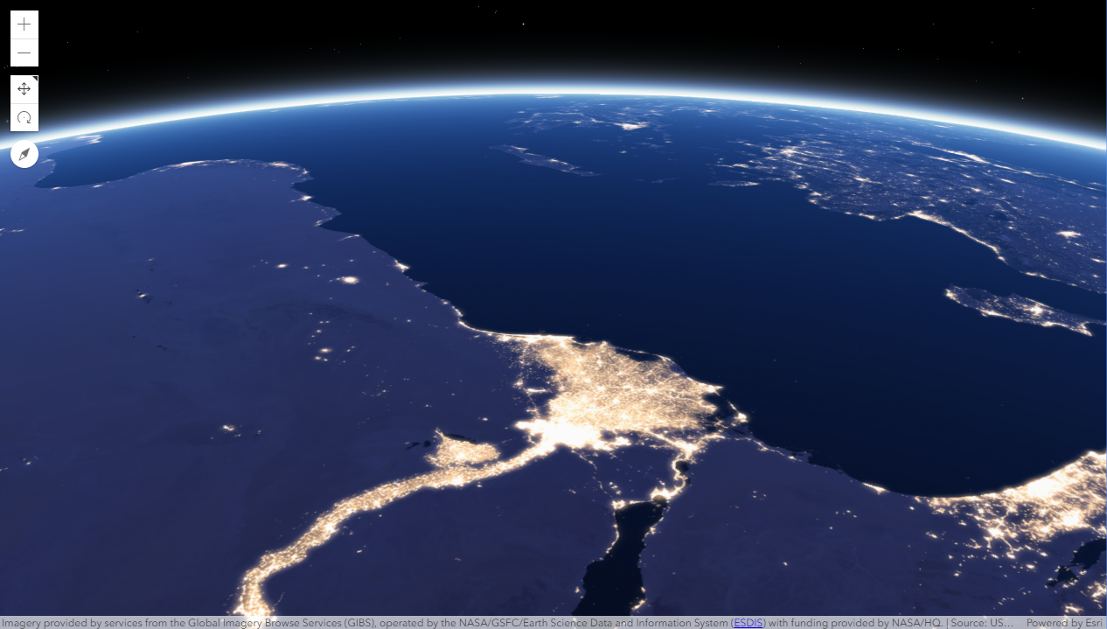
DEMO
“Earth at Night, Mountains of Light”
Step 1: SceneView with WebTileLayer pointing at NASA tiled image service
https://github.com/jwasilgeo/esri-experiments

Slide 14
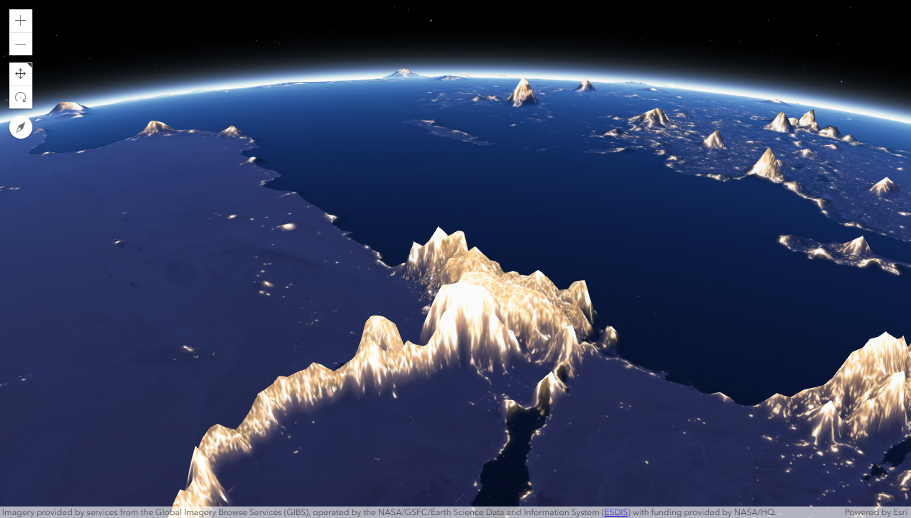
DEMO
“Earth at Night, Mountains of Light”
Step 2: BaseElevationLayer driven by NASA WebTileLayer, helped by chroma.js to turn colors into height
https://github.com/jwasilgeo/esri-experiments

Slide 15
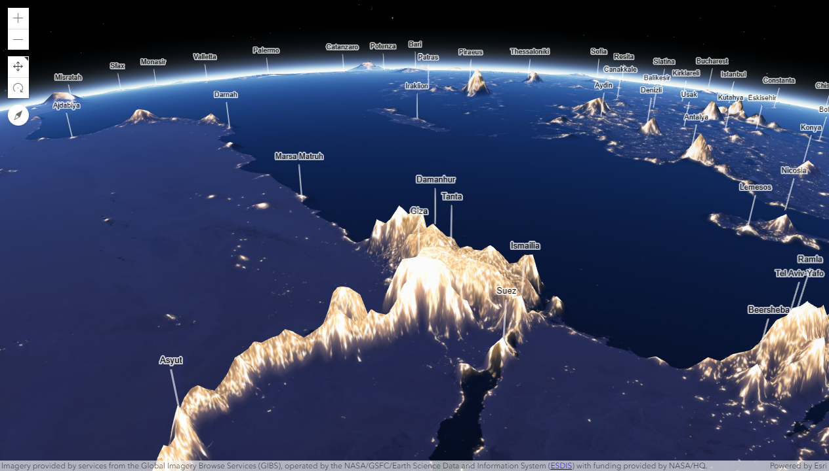
DEMO
“Earth at Night, Mountains of Light”
Step 3: Add a FeatureLayer with callout labels to show cities
https://github.com/jwasilgeo/esri-experiments

Slide 16
Deep dive: “Earth at Night, Mountains of Light”
JSAPI BaseElevationLayer details
load() method
establish and rely on a WebTileLayer instance pointing to NASA tiled image service
fetchTile() method
get nighttime image tiles
convert image pixel colors to exaggerated elevation values
return a promise that resolves to an ElevationTileData object
chroma.js API details
luminance() method
relative brightness of a color
[R, G, B] to 0 - 1

Slide 17
Resources
Blog post about “Earth at Night, Mountains of Light”
https://petrichor.studio/2019/02/14/earth-at-night-mountains-of-light/
Dev Summit 2018: “ArcGIS API for JavaScript: Creating Custom Layers”
http://proceedings.esri.com/library/userconf/devsummit18/papers/dev-int-018.pdf
Official docs for “Layer” and “LayerView”
https://developers.arcgis.com/javascript/latest/api-reference/esri-layers-Layer.html
https://developers.arcgis.com/javascript/latest/api-reference/esri-views-layers-LayerView.html
https://developers.arcgis.com/javascript/latest/sample-code/intro-layers/index.html

Slide 18
Upcoming Presentations this Week
Advanced WebGL in 2D Map Views with the ArcGIS API for JavaScript
Thursday, March 07, 1:00 pm - 1:30 pm
Demo Theater 1: Oasis 1-2
Dario D’Amico, Yaron Fine, Matthew George
Advanced WebGL in 3D Scene Views with the ArcGIS API for JavaScript
Thursday, March 07, 1:30 pm - 2:00 pm
Demo Theater 1: Oasis 1-2
Stefan Eilemann

Slide 19


Slide 20

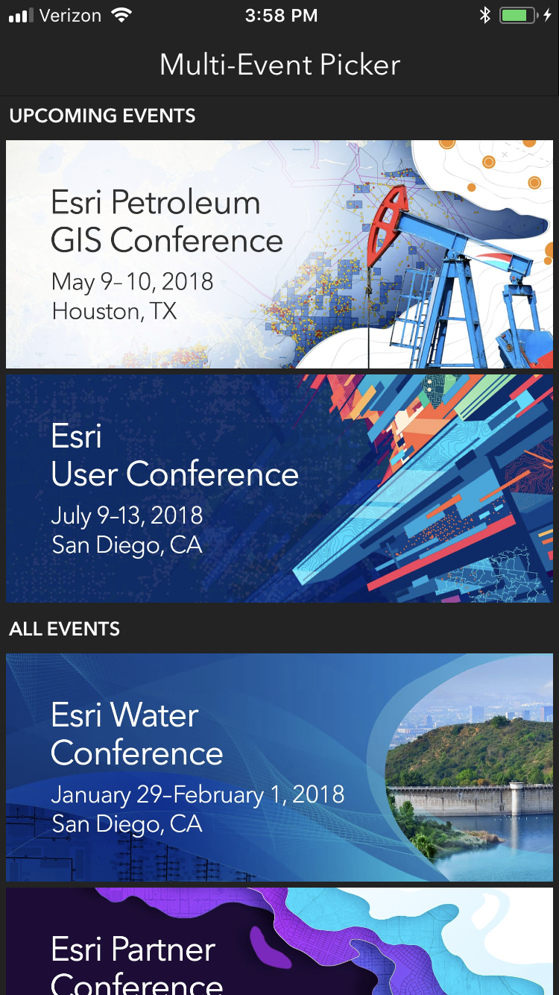
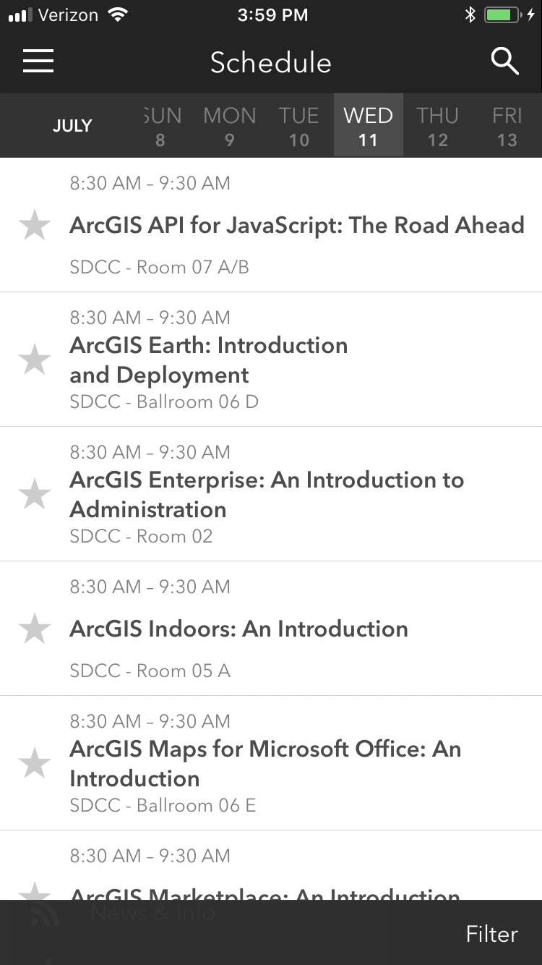
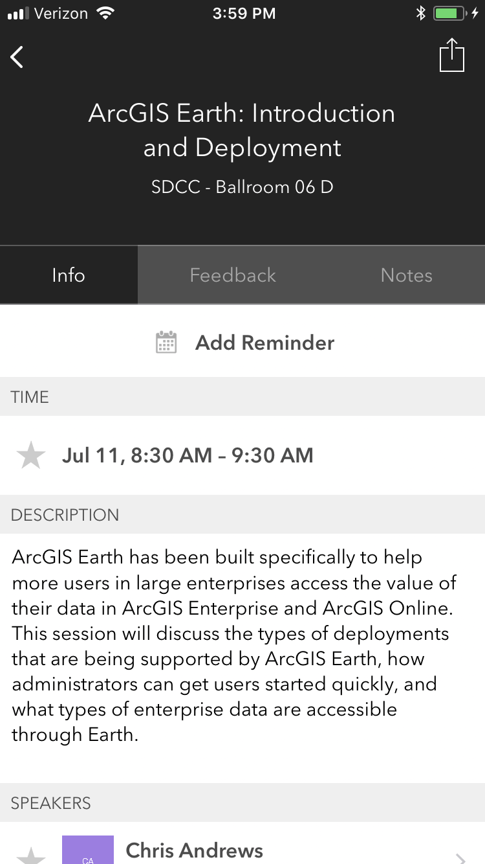
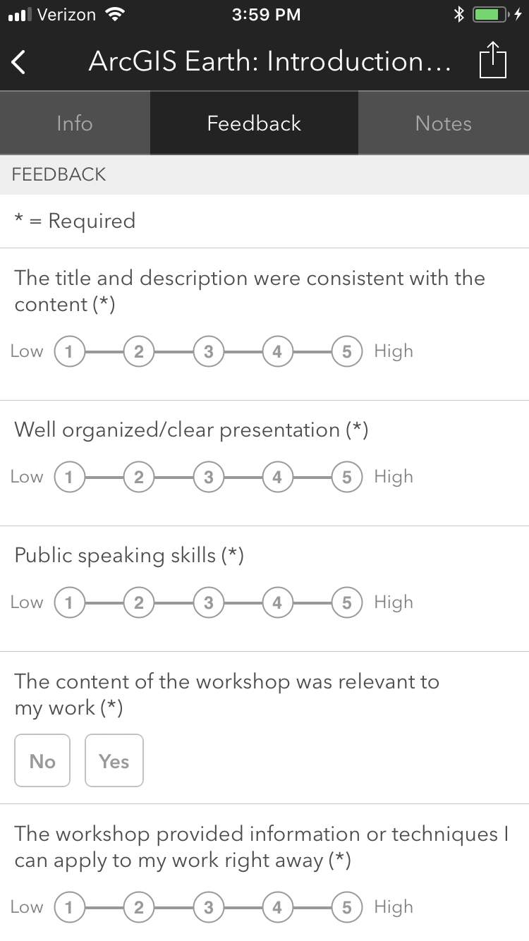
Please Take Our Survey on the App
Download the Esri Events app and find your event
Select the session you attended
Scroll down to find the feedback section
Complete answers
and select “Submit”

Slide 21
Presentation Title
Presenter Names
2019 ESRI DEVELOPER SUMMIT
Palm Springs, CA
Notes:
G243257 DevSummit 2019 Template for Esri staff

Slide 25
Click Here For DEMO
Sample Name Here

Slide 27
Please Take Our Survey on the App
Download the Esri Events app and find your event
Select the session you attended
Scroll down to find the feedback section
Complete answers
and select “Submit”

